Slide 1
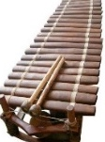
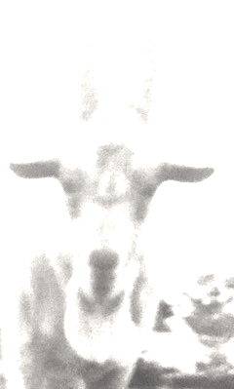
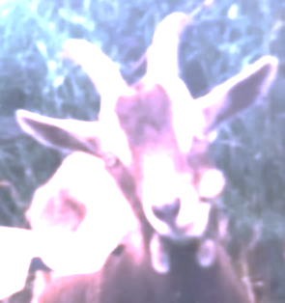
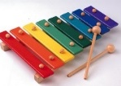
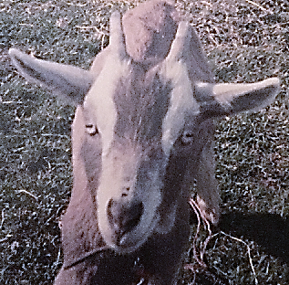
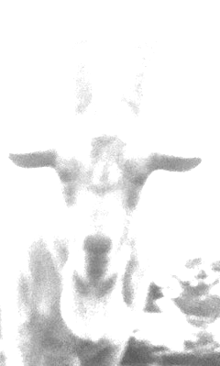

Supervised and unsupervised learning
Are labels Y given/used?
yes
no
supervised learning
unsupervised learning
discrete
continuous
classification
(output: Goat)
regression
(output: £3.14)

Slide 2
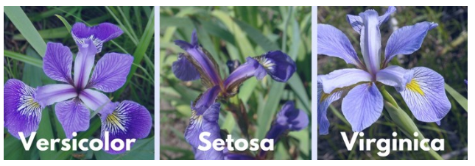
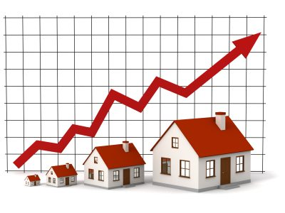
Supervised learning types of predictions
Classifiers try to predict a category in a range of discrete values
Regressors try to predict a real number in a range of continuous values
1.000.000 £
100.000 £

Slide 3
How to decide if we have a regression or classification problem?
Are you interested to predict values between a Versicolor Iris and a Virginica Iris?
If YES is a plausible answer:
Regression
If NO is a plausible answer:
Classification
Are the classes linear sorted?
Issues?
Are you interested to predict values between a House price of 100k and a 1M pounds?
Are the values binned?
If YES is a plausible answer:
Regression
If NO is a plausible answer:
Classification
Issues?

Slide 4
Questions:
For the exercise “Wine Quality Prediction” we used a Classification model. Could we also use a Regression model?
Assuming that Versicolor is 0, Setosa is 1 and Virginica is 2. If we used a regression model for the “Iris dataset” what species of flower we have if the model predicts a value of 1.85 ?

Slide 5
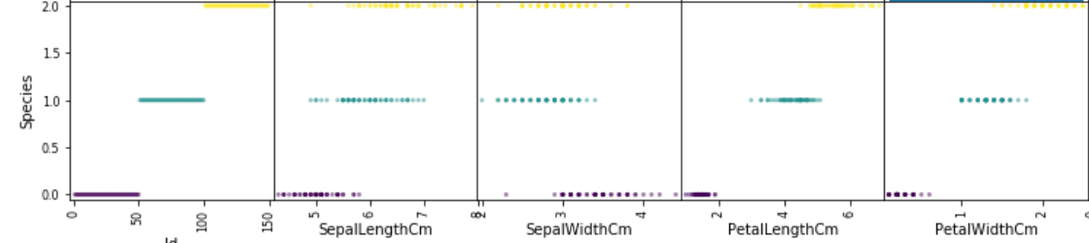
Answers:
For the exercise “Wine Quality Prediction” we used a Classification model. Could we also use a Regression model? YES. For example 3 is a better quality value than 2 and 2.5 could be a meaningful quality value.
Assuming that Versicolor is 0, Setosa is 1 and Virginica is 2. If we used a regression model for the “Iris dataset” what species of flower we have if the model predicts a value of 1.85 ? Probably Virginica. But this can be argued if the features describe the data in a not linear pattern (sorted). In other words 1.85 can still be a Setosa and only a Senior Botanist can tell us.
1.85

Slide 6
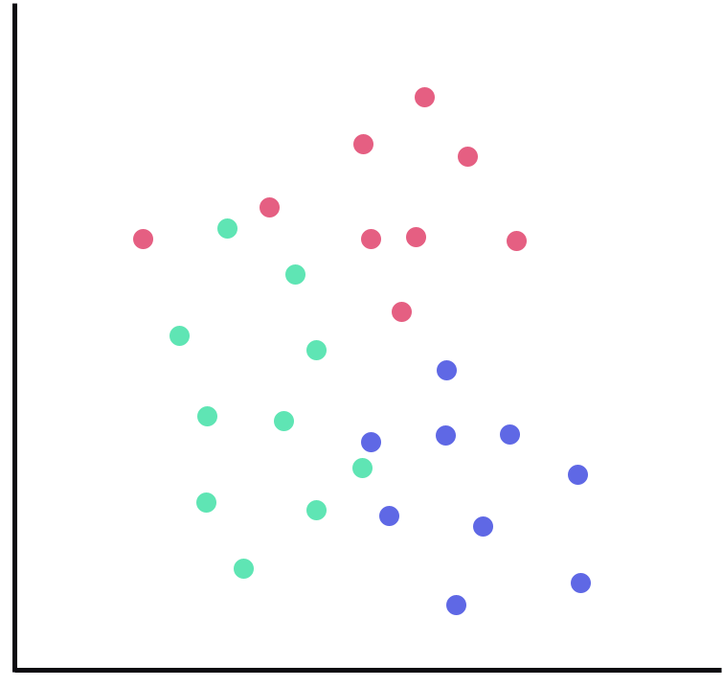
KNN (Classification) How it works
90k
I asked 29 people their favourite color and I annotated the age and salary for each individual.
Now there is a new person 55 years old and 80k of salary. What is the favourite color of this new person? How would you classify this new point? Red, blue or green?
Think for a moment the method that you used to make the prediction?
Salary
We look at the nearests examples and we assign the color of that examples to the new data point. In this case red.
0
Age
110

Slide 7
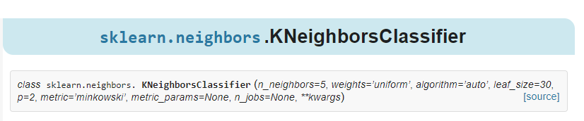
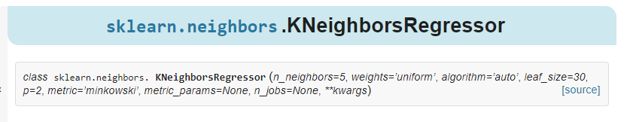
Scikit Learn
https://scikit-learn.org/stable/modules/generated/sklearn.neighbors.KNeighborsClassifier.html#sklearn.neighbors.KNeighborsClassifier
https://scikit-learn.org/stable/modules/generated/sklearn.neighbors.KNeighborsRegressor.html#sklearn.neighbors.KNeighborsRegressor

Slide 8
The previous steps in animation.
2.8
0.5
3
K = 3
2.4
[ 0.5, 2.4, 2.8, 3, 5.5 ]
5.5
Distances calculation
Sorting the distances
Majority of votes

Slide 9
Steps
With KNN learning and prediction happen at the same time.
We give a path to load the training data to the KNN (the training data contain the features and the targets for each data instances)
We ask KNN to make a prediction on a new data for which we have the features but not the target
KNN looks at the features of this new data and creates a list of all the distances from this new data and all at the other data in the training set
Once KNN calculated and stored in a list the distances (similarity) between this new data and all the others instances, it sorts this list by distance values. Instances at the beginning of the list will be closer points to the new data.
It locate the K most similar data instances in the training dataset to the new data, by selecting the first K items of the sorted list.
Once we have located the most similar neighbors for a new data instance, the next task is to make a prediction based on those neighbors. We can do this by allowing each neighbor to vote for their class attribute, and take the majority vote as the prediction.

Slide 10
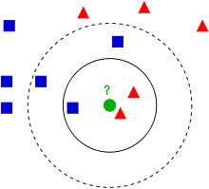
Number of K
Large K : ?
Large K : everything classified as the most probable class.
Small K : ?
Small K : highly variable, very sensitive to outliers
K = 3
Test different K against your train and test set and find the one that generalise better
K = 5

Slide 11






Distance - We used our vision ability to spot the nearest neighbors - The computer uses distance metrics
Euclidean Distance
d $=\sqrt{{\left(x_{2}−x_{1}\right)}^{2}+{\left(y_{2}−y_{1}\right)}^{2}}$
$$\left(x_{1},y_{1}\right)$$
$$d$$
$$y_{2}−y_{1}$$
$$x_{2}−x_{1}$$
$$\left(x_{2},y_{2}\right)$$

Slide 12

Distance - We used our vision ability to spot the nearest neighbors - The computer uses distance metrics
Manhattan Distance
d $=|x_{2}−x_{1}|$ + $|y_{2}−y_{1}|$
$$\left(x_{1},y_{1}\right)$$
$$y_{2}−y_{1}$$
$$x_{2}−x_{1}$$
$$\left(x_{2},y_{2}\right)$$

Slide 13
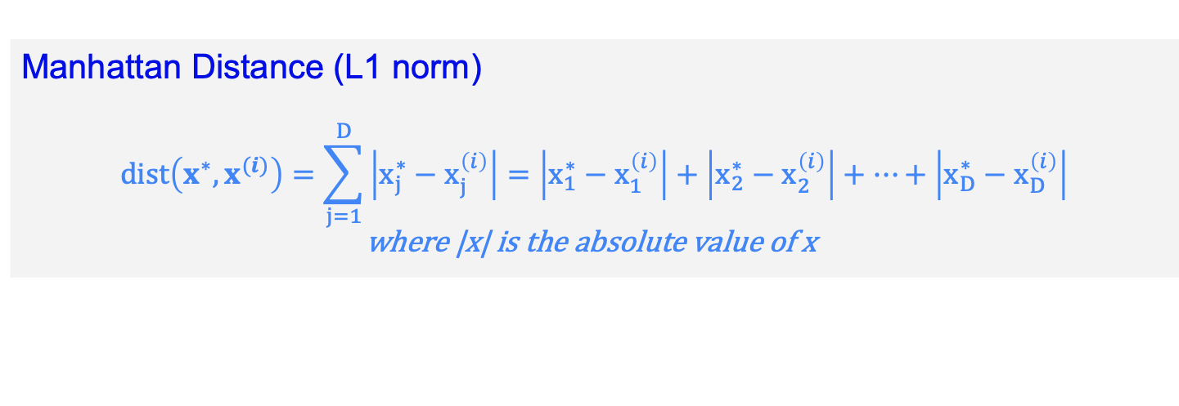
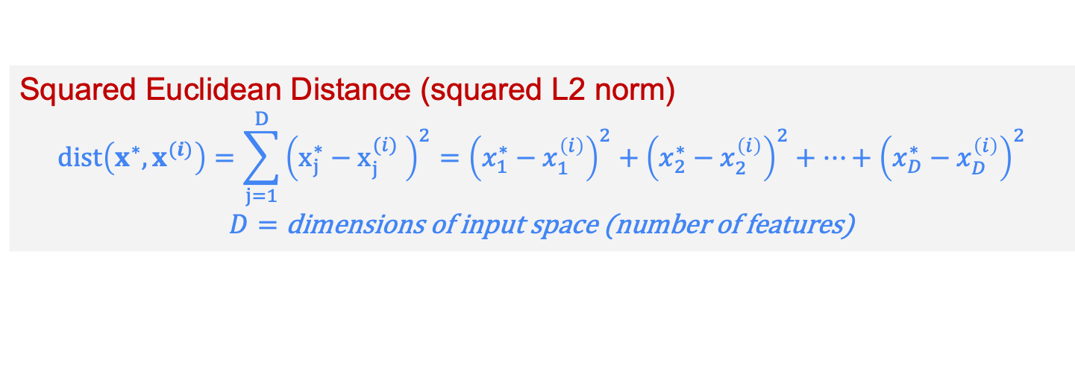
Other distance measures
Squared Euclidean Distance (squared L2 norm)
$$dist\left(x^{∗},x^{(i)}\right)=\sum_{j=1}^{D}{{\left(x_{j}^{∗}−x_{j}^{(i)} \right)}^{2}={\left(x_{1}^{∗}−x_{1}^{\left(i\right)}\right)}^{2}+{\left(x_{2}^{∗}−x_{2}^{\left(i\right)}\right)}^{2}+…+{\left(x_{D}^{∗}−x_{D}^{\left(i\right)}\right)}^{2}} \\ D=\text{dimensions} \text{of} \text{input} \text{space}\text{ (}\text{number} \text{of} \text{features}\text{)}$$
Manhattan Distance (L1 norm)
$$dist\left(x^{∗},x^{(i)}\right)=\sum_{j=1}^{D}{\left|x_{j}^{∗}−x_{j}^{\left(i\right)}\right|}=\left|x_{1}^{∗}−x_{1}^{\left(i\right)}\right|+\left|x_{2}^{∗}−x_{2}^{\left(i\right)}\right|+…+\left|x_{D}^{∗}−x_{D}^{\left(i\right)}\right| \\ \text{where}\text{ |}\text{x}\text{| }\text{is} \text{the} \text{absolute} \text{value} \text{of} \text{x}$$

Slide 14
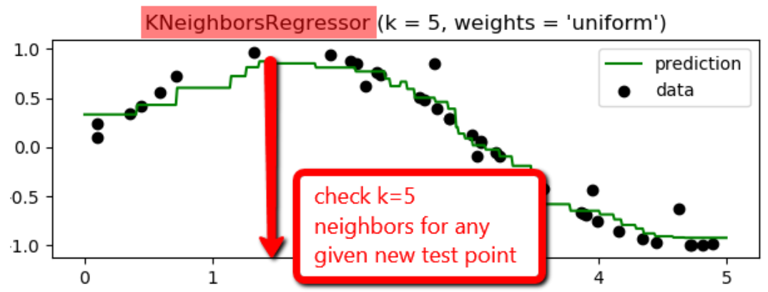
Works also for regression , instead of max votes uses the mean value of neighbors

Slide 15
KNN
The k-nearest neighbor (k-NN) algorithm is based on the intuition that similar instances should have similar class labels (in classification) or similar target values (regression). The algorithm is very simple, but is capable of learning highly-complex non-linear decision boundaries and regression functions. On the downside, the algorithm is computationally expensive, and is prone to overfitting.
There is not a actual training step but the training happens at the time of prediction
Easy to update in online setting: just adding item to the training set
Does not work if there are missing data (we need to fill in the missing information)
Sensitive to class-outliers (see next slides)
Computational expensive, need to store all the training examples (space) need to compute all the distances and sort them during prediction
Mainly choose the K and eventually the distance function (see next slides)
To avoid overfitting we keep testing between training and testing data to see which K works better

Slide 16
Fit (train) a KNN
Fitting a classifier means taking a data set as input, then outputting a classifier, which is chosen from a space of possible classifiers. In many cases, a classifier is identified--that is, distinguished from other possible classifiers--by a set of parameters. The parameters are typically chosen by solving an optimization problem or some other numerical procedure. But, in the case of knn, the classifier is identified by the training data itself. So, at an abstract level, fitting a knn classifier simply requires storing the training set.
Let’s have a look at an example in practice

Slide 17
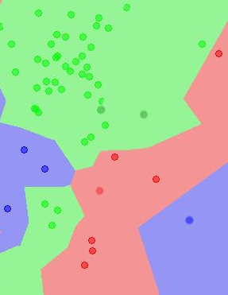
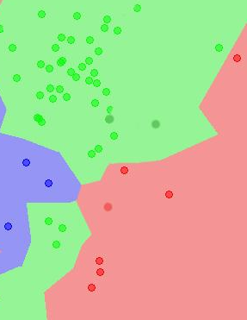
Advanced concepts
Sensitive to outliers
We had a dataset that we annotated with care.
Than we updated this dataset with a new training instance. But we made a mistake with the label. It was red but we typed blue
A small error causes a big problem. A single mistake takes a wide area
Insensitive to class prior
There are many more green points than red points but the areas are almost equal

